Slide 1


Capstone Project
Thermal Insulator from Buffing Dust
Group :11
ID : 2011049-2011054

Slide 2
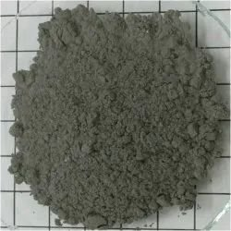
Overview:
We aim to make a thermal insulator from buffing dust which mainly aims to recycle approximately 1.18 × 10⁴ –3.54 × 10⁴ tonne waste generated in tannery industries

Slide 3
Materials :
Buffing Dust
Polystyrene
Blowing Agent

Slide 4
Materials & Their Costing:
Buffing Dust
Collected from Tanneries
Polystyrene
200 tk/kg
650 tk/500 gm
Citric Acid

Slide 5
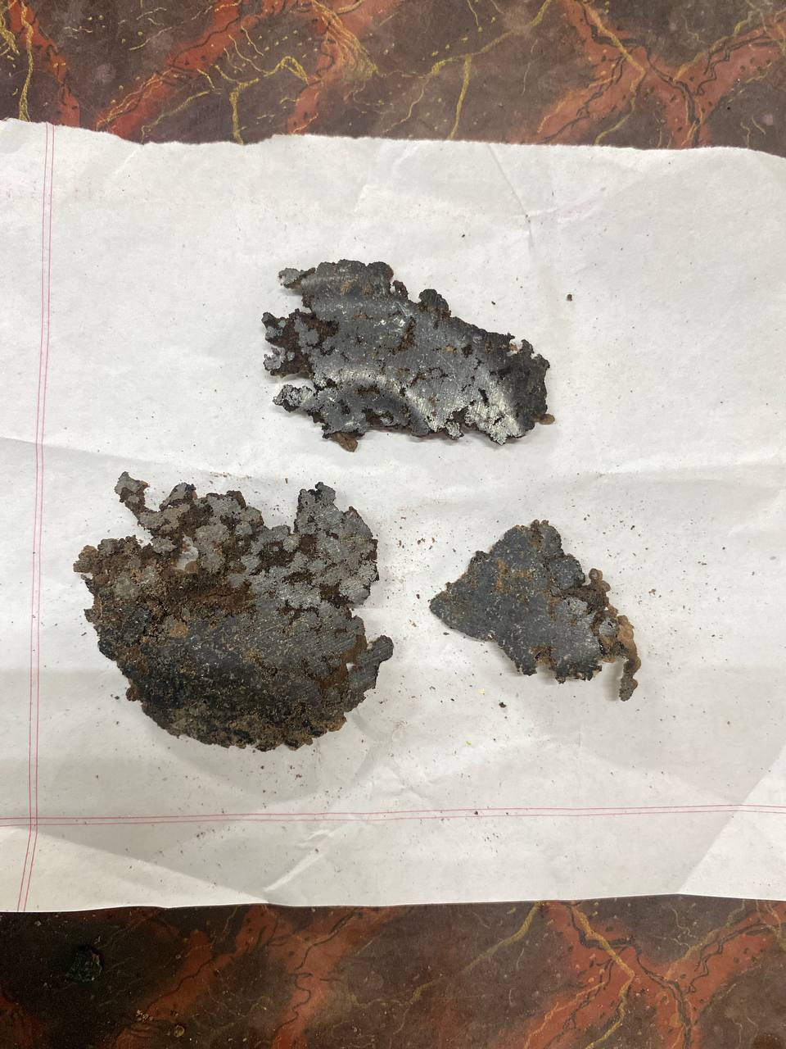
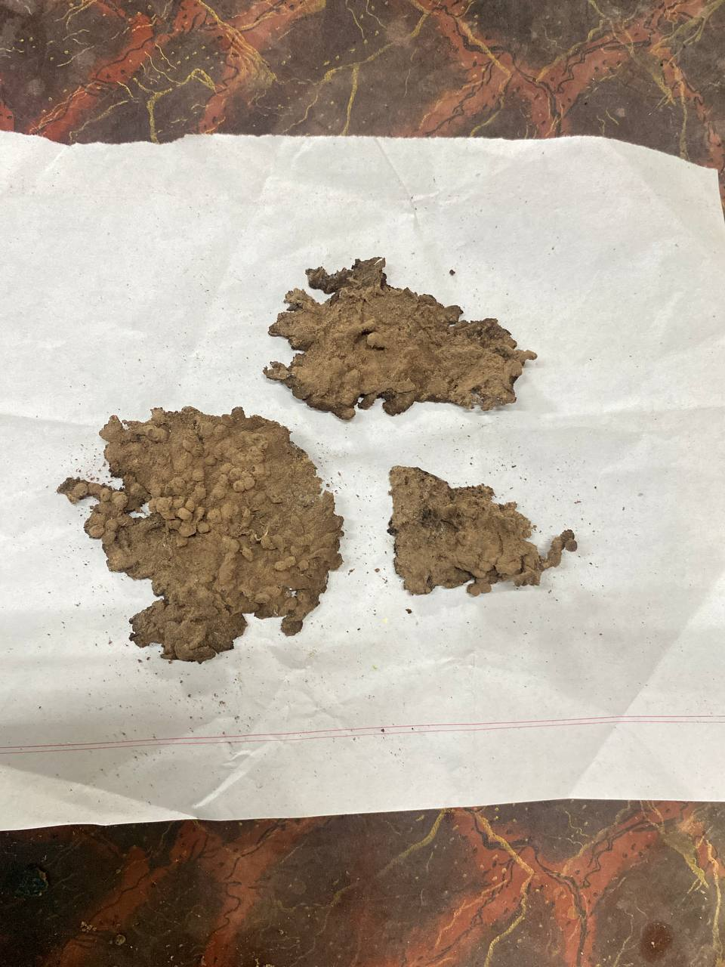
Attempt one:
Material Ratio
Polystyrene : Buffing Dust
77 : 23

Slide 6
Attempt one:
Result:
Brittle Material
Clear Sound Upon Cracking
Apparently hard

Slide 7
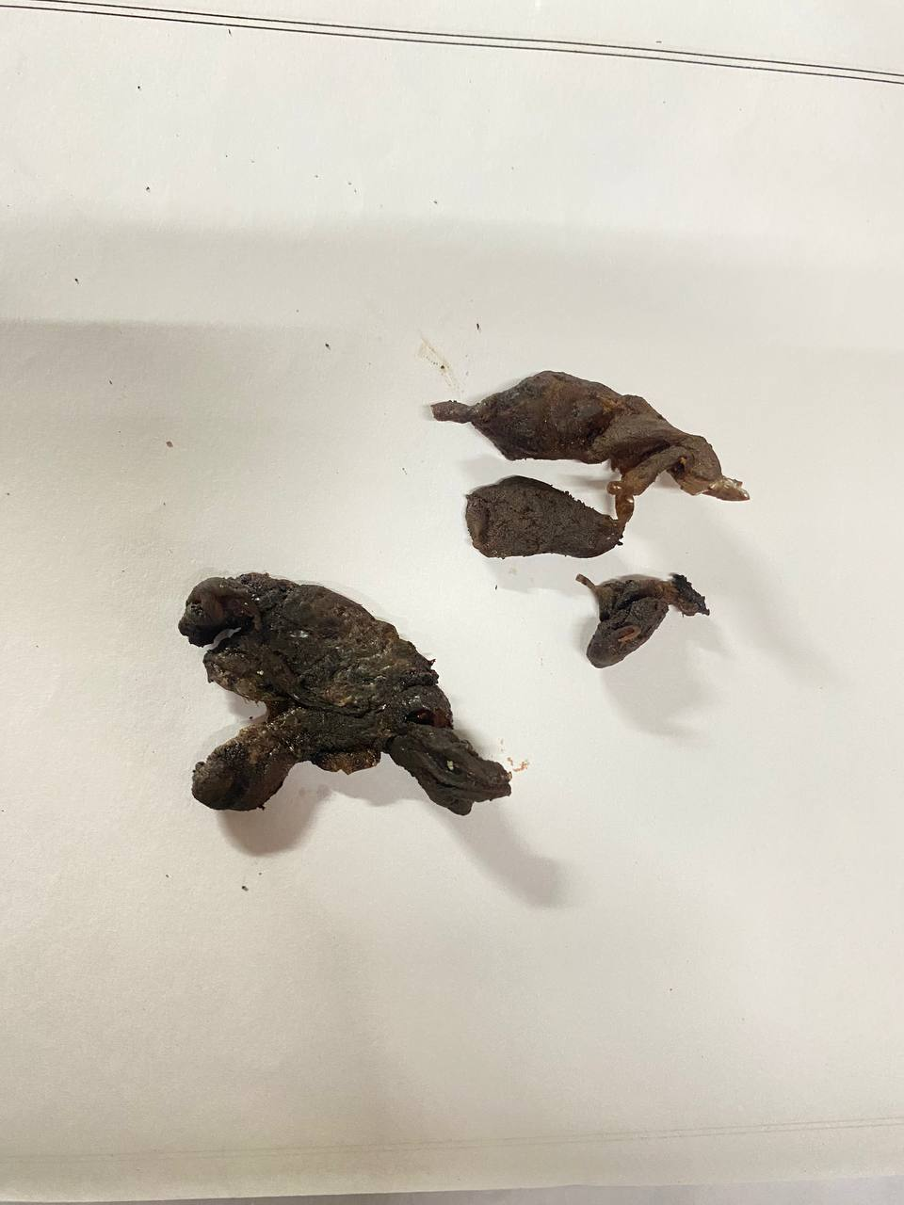
Attempt TWO:
Material Ratio
Polystyrene : Buffing Dust : Citric Acid
77 : 20 : 3

Slide 8
Attempt Two:
Result:
Less Hard
More foamy
Clear sound upon cracking

Slide 10

Current Problem:
Absence of High to low pressure transition

Slide 11
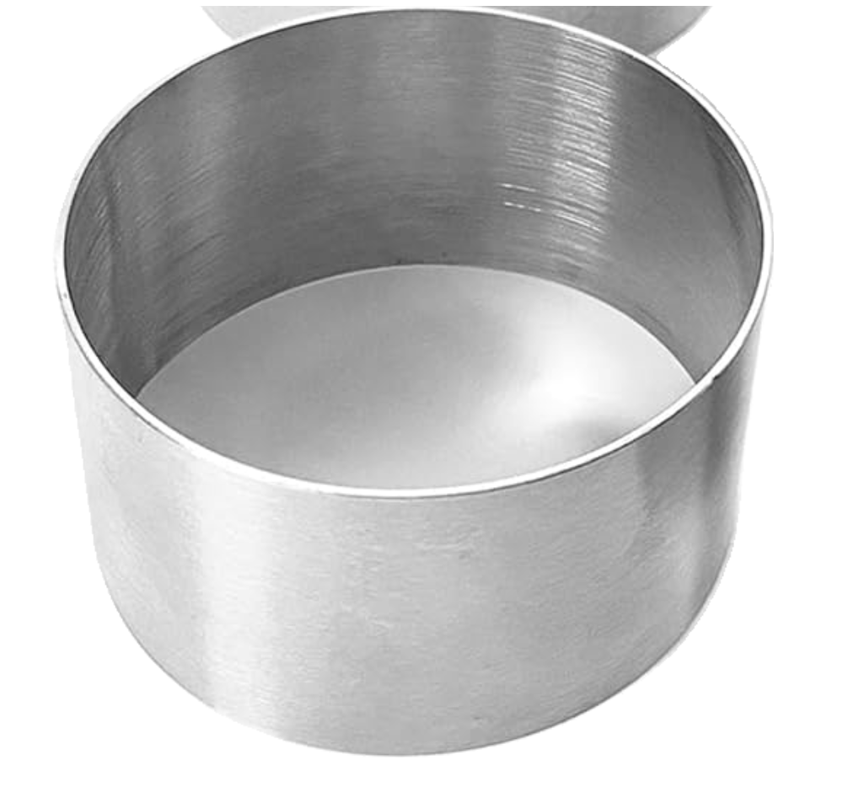
Requirements:
A Mould from Stainless Steel

Slide 12
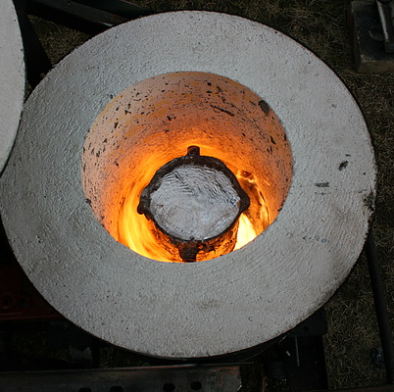
Requirements:
Access to electric arc furnace

Slide 13
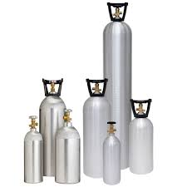
Requirements:
High Pressure co2 gas

Slide 14

Thank you

